Slide 1
Gender Disparity in the Technology Industry: a deeper look at the UK situation.
Done by: Betty Abate, Kamile Sudziute, Monaliza Wohlers, Rachel Cunningham and Safia Elmi.

Slide 2
Current research states that between 10-30% of roles in technology roles are held by women, and even less in senior positions (Harvery Nash Tech Survey, 2021; Office for National Statistics, 2021). This is an investigation on the disparity that exists in the UK and if there are any regional differences and the trends in gender disparity over time.

Slide 3
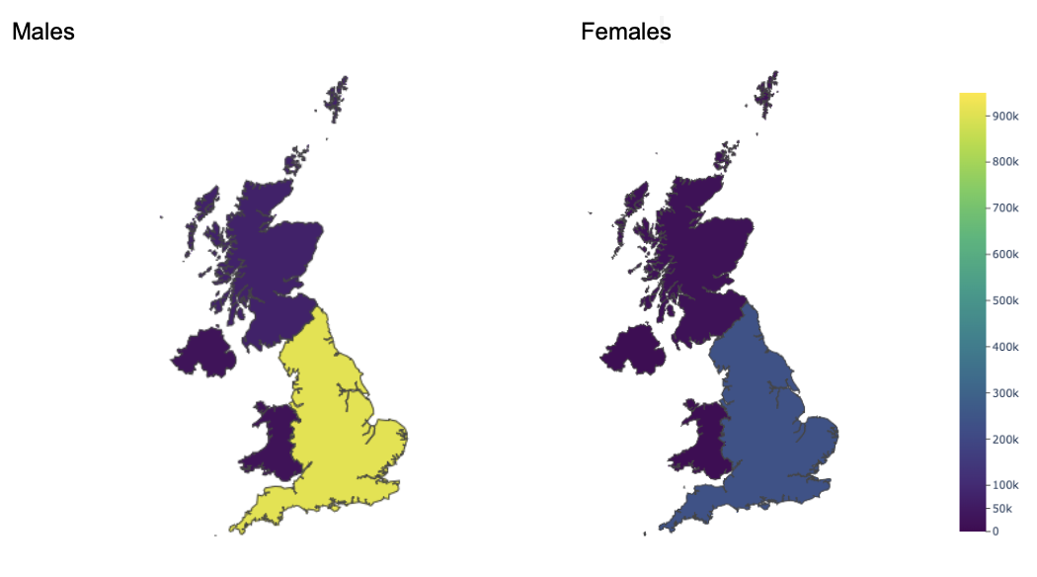
Difference in total males and females in the technology industry in 2021

Slide 4
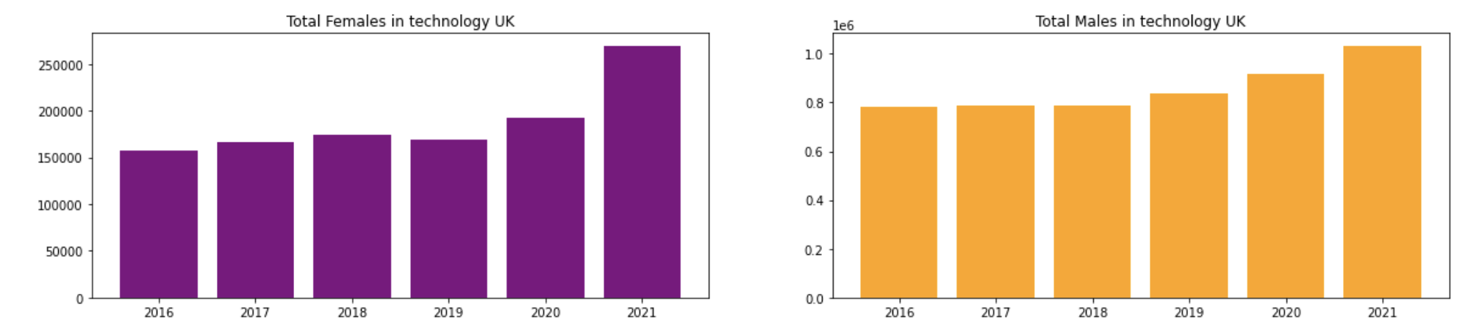
Total Males & Females in technology in the UK over the years

Slide 5
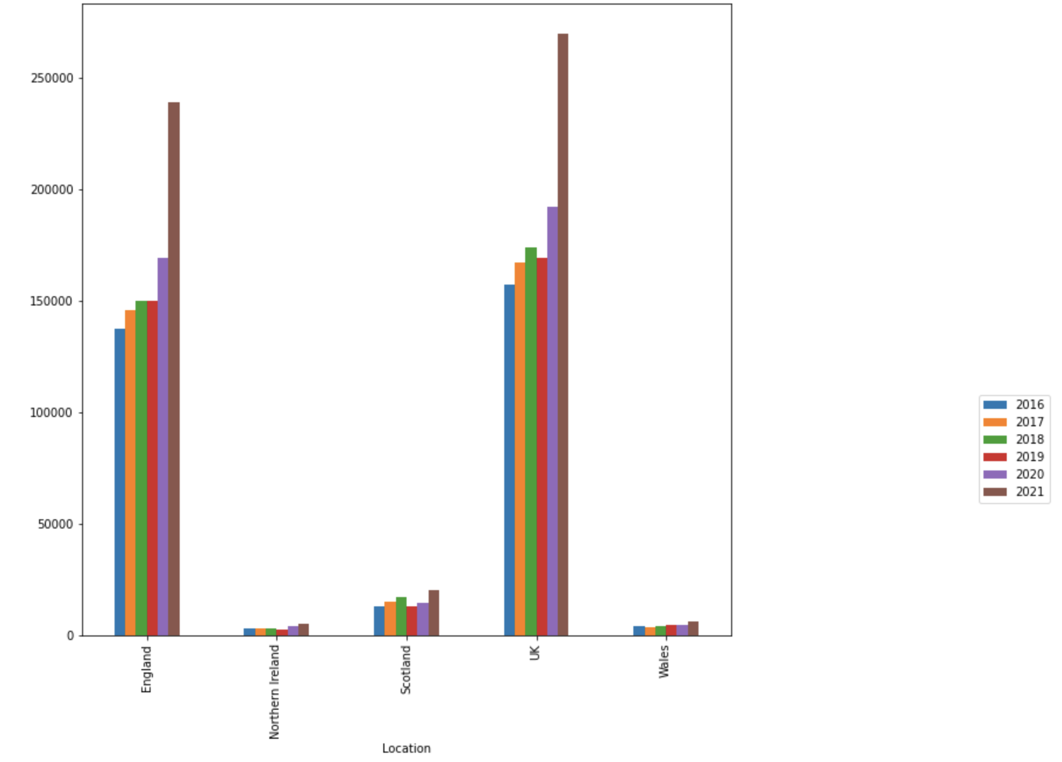
Female growth over 5 years

Slide 6
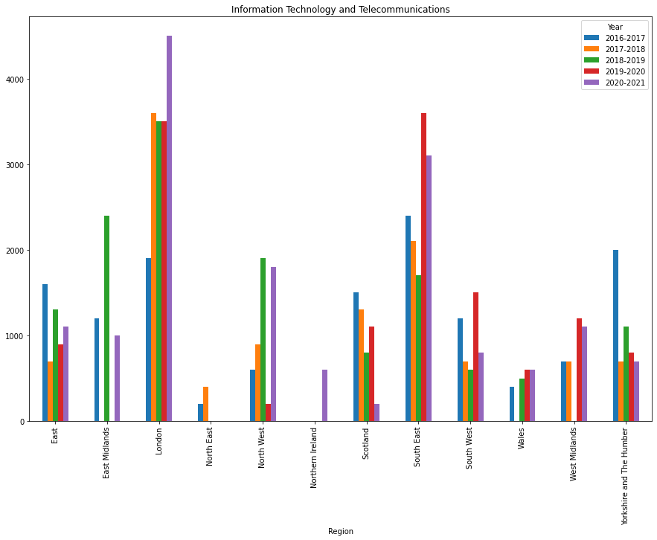
Information Technology and Telecommunications

Slide 7
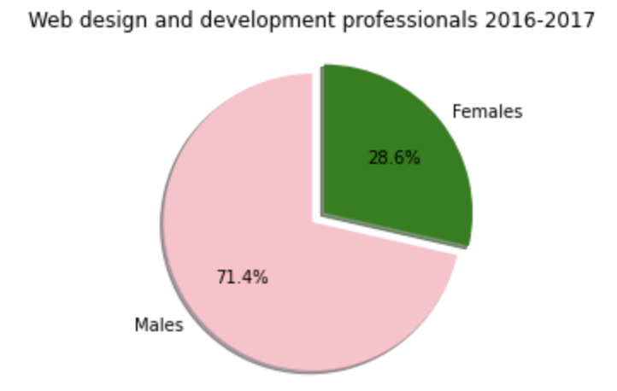
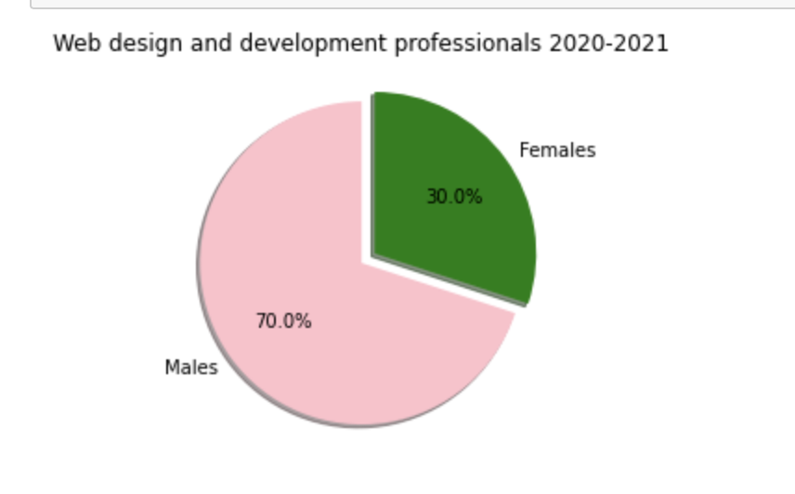
Web design comparison 16/17 & 20/21

Slide 8

Key findings
The change in the difference between males and females in the technology industry in the UK does seem to be decreasing over time.
There have been few changes to the difference between the number of males and females in that field in the last five years.
There have been several initiatives to encourage greater female representation in the technology industry in the UK.
It will take several years before it can be seen the impact of initiatives that encourage females in this field.

Slide 9





Team Presentation
Safia
Rachel
Monaliza
Kamile
Betty

